Slide 1


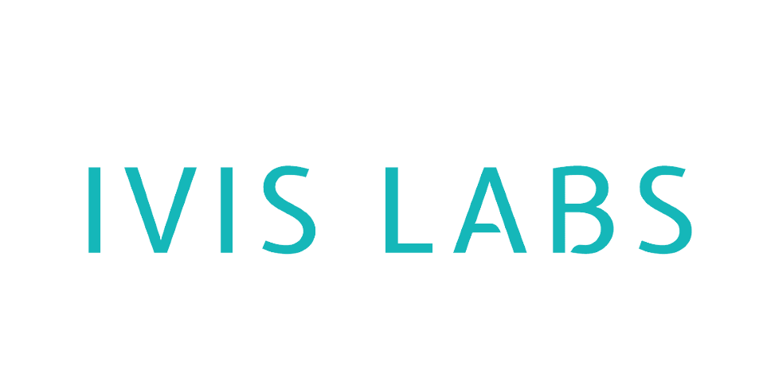
Technical Support Knowledge Base

Slide 2
Presented by:
Ananya S 4NI22CS027
Anush 4NI22CS028
Anusha D 4NI22CS029
Arunkumar 4NI22CS030
B R Shreenaag 4NI22CS032

Slide 3
Introduction
A system for the technical support team to quickly access troubleshooting steps.
Built using FastAPI for high performance and scalability.
Integrates an AI-powered API for dynamic troubleshooting.
Uses Jinja2 for rendering web pages.

Slide 4
Tech Stack Used
FastAPI – API Framework
Jinja2 – Template Rendering
HTTPX – Asynchronous HTTP Requests
Pydantic – Data Validation
Uvicorn – ASGI Server

Slide 5
Project Architecture
Frontend: HTML Templates with Jinja2
Backend: FastAPI for API and logic
External API: Calls troubleshooting AI for responses
Static Files: CSS, JavaScript for UI styling

Slide 6
Core Features
Home Page (`/`): Displays troubleshooting form
Troubleshoot Endpoint (`/troubleshoot`): Accepts issues and returns solutions
Available Models (`/models`): Lists AI models for troubleshooting
Uses API key authentication for security

Slide 7
API Integration Details
Uses `httpx.AsyncClient` for async API calls
External API URL: `https://chat.ivislabs.in/api`
Sends POST request to `/chat/completions`
Uses API key authentication
Retrieves AI-generated troubleshooting steps

Slide 8
Error Handling & Exceptions
Uses try-except blocks for API request failures
Handles invalid responses and timeout issues
Returns meaningful error messages to users
Ensures robust error logging

Slide 9
Running the Application
1. Install dependencies:
`pip install fastapi uvicorn httpx jinja2 pydantic`
2. Run the FastAPI server:
`uvicorn main:app --host 0.0.0.0 --port 8000 -- reload`
3. Access the web interface at `http://localhost:8000`

Slide 10
Future Enhancements
User Authentication for secure access
Database Integration to store troubleshooting history
Enhanced UI for better user experience
Multi-language support for broader accessibility

Slide 11
Conclusion
FastAPI enables fast and scalable API development.
AI-powered troubleshooting improves efficiency.
Can be extended with more features and integrations.
Provides a robust solution for tech support teams.

